Slide 1
MICROSOFT AZURE
PHANI KISHORE LANKA

Slide 2
Course Content
Understanding Cloud Computing Basics
Azure Overview & Understanding Azure Services
Chapter 1 → Azure Storage
Chapter 2 → Azure Network
Chapter 3 → Azure Compute
Chapter 4 → Azure App Services
Chapter 5 → Azure Databases
Chapter 6 → Azure Big Data
Chapter 7 → Azure EAI (Enterprise Application Integration)
Chapter 8 → Azure IOT (Internet of Things)
Chapter 9 → Azure Security
Chapter 10 → Azure Automation

Slide 3
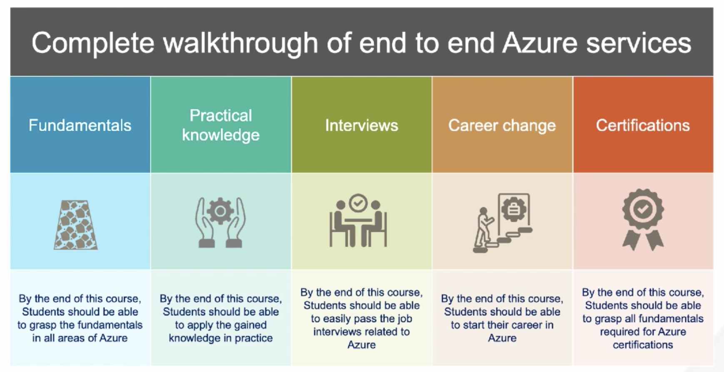
Outcome of Course

Slide 4
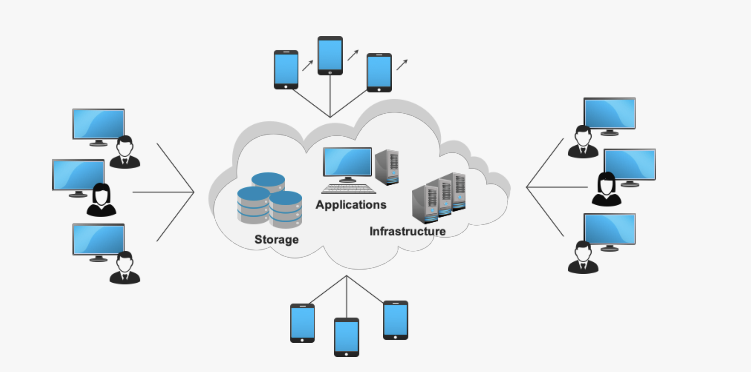
Cloud Computing
Cloud Computing is the Delivery of Computing Services – Servers, Storage, Network,
Software , Analytics , Intelligence and more over the Internet (“THE CLOUD”)
Companies that offer these services are called Cloud Providers (AWS/Azure/GCP/OCI/IBM)
Typically Cloud Computing Services will be charged based on Usage (PAY AS YOU GO MODEL)

Slide 5
Benefits of Cloud Computing
COST - Hugely Reduce Captial Costs for Buying H/w & S/w
SPEED – Resources can be provisioned in Minutes with few mouse clicks
SCALABILITY – Resources can be scaled up and down with in mins according to Business Requirements.
PRODUCTIVITY – Cloud Computing Takes out H/w Setup, Patching etc, so IT Team can focus on Achieving Business Goals.
RELIABILITY – Cloud Computing makes Data Backup , DR & Business Continuity Less expensive and faster Recovery.
SECURITY – Various Security Levels, Various Policies/Technology Based Controls that strengthen Security Posture Overall.

Slide 6
Types of Cloud Computing
Public Cloud - Public clouds are owned and operated by a third-party cloud service provider, which delivers computing resources such as servers and storage over the Internet.
Private Cloud – Private cloud refers to cloud computing resources used exclusively by a single business or organization. A private cloud can be physically located on the company’s on-site datacenter. Some companies also pay third-party service providers to host their private cloud.
Hybrid Cloud - Hybrid clouds combine public and private clouds, bound together by technology that allows data and applications to be shared between them. hybrid cloud gives businesses greater flexibility and more deployment options.

Slide 7
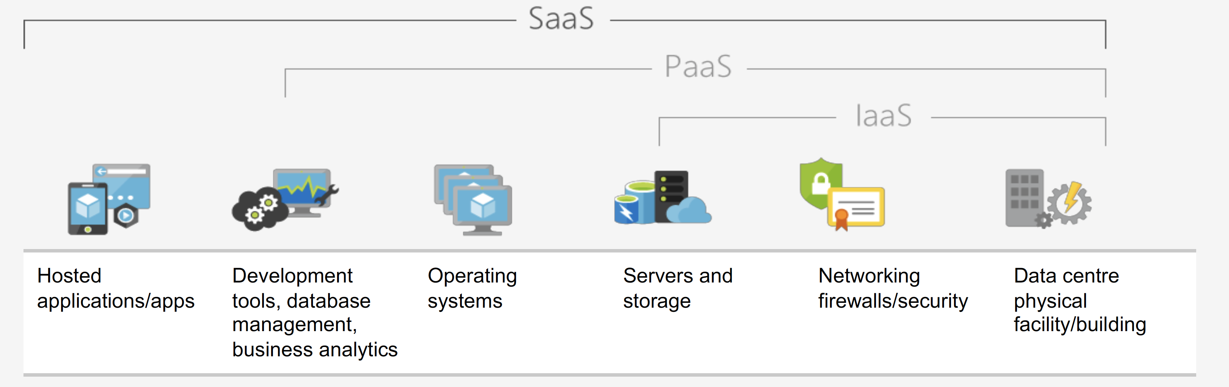
Models
Infrastructure as Service (IAAS) - With IaaS, you rent IT infrastructure - servers and
virtual machines (VMs), storage, networks, operating systems from a cloud provider
on a pay-as-you-go basis
2. Platform as a Service (PAAS) – Platform as a service (PaaS) refers to cloud computing
services that supply an on-demand environment for developing, testing, delivering and
managing software applications
3. Software as a Service (SAAS) - Software as a service (SaaS) is a method for delivering
software applications over the Internet, on demand and typically on a subscription basis.

Slide 8

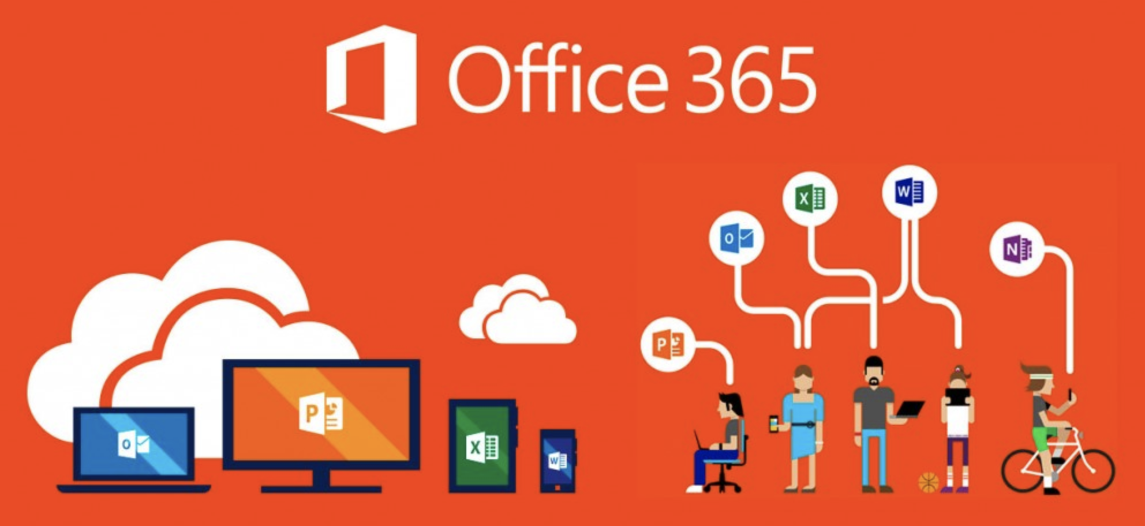
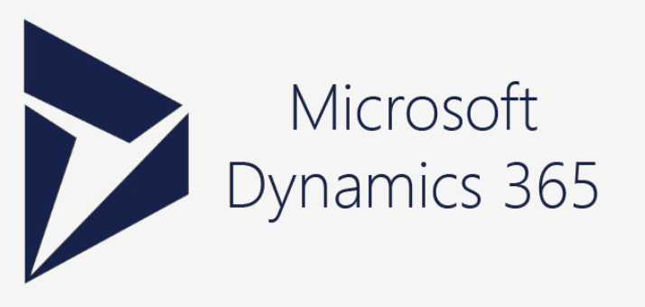
Microsoft Cloud Services
Collection of Integrated Cloud Services
Microsoft Office Suite Software over the Cloud
Cloud ERP & CRM Solution , Includes total of 11+ Apps

Slide 9
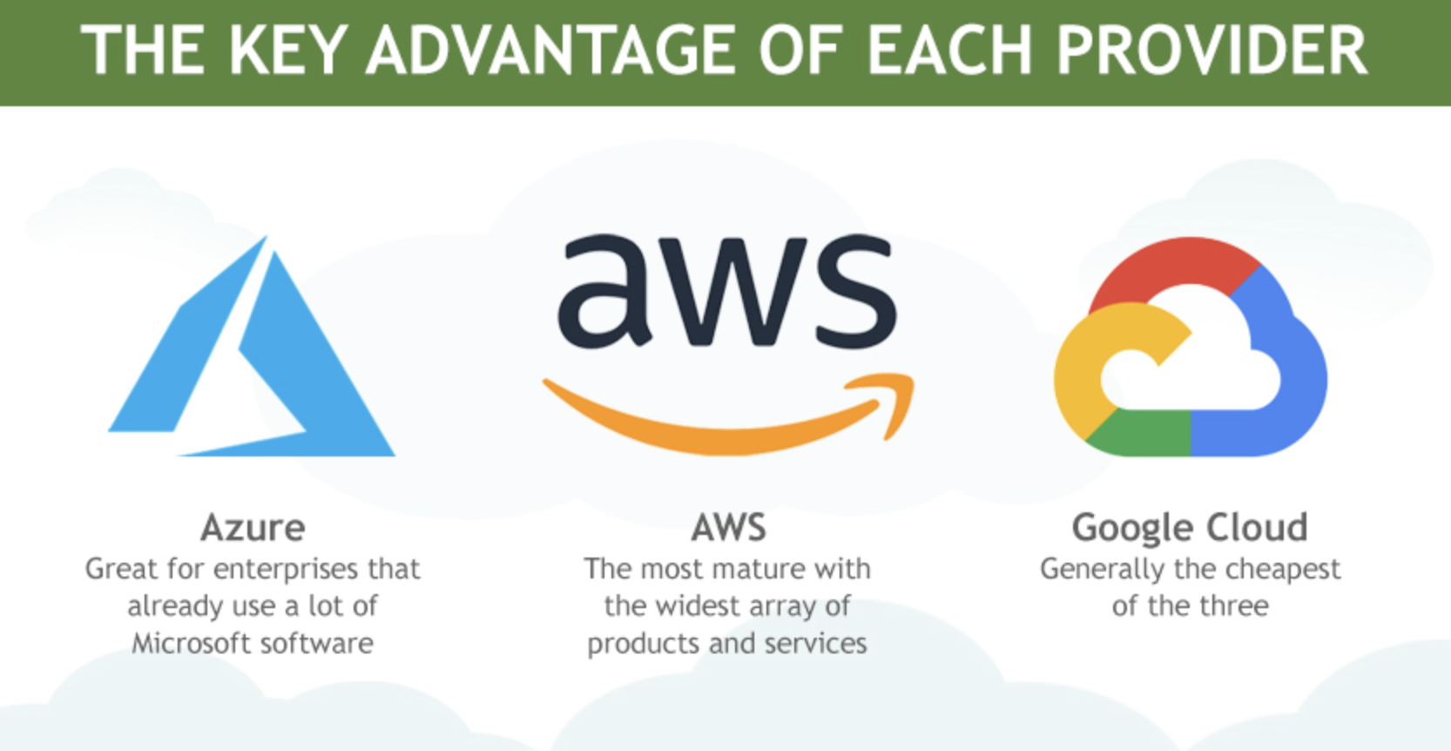
Which Cloud is Best

Slide 10
Azure - CapX Vs OpEx
CapX – Captital Expenditure , Pay Upfront for Hardware.
OpEx – Operational Expenditure. Spending on the service now and billed now, This is how Azure Works.

Slide 11
Azure Compliance
Criminal Justice Information Services (CJIS)
CSA STAR Certification, This STAR Certification is based on Achieving ISO/IEC 27001 Certification.
General Data Protection Regulation – GDPR European Privacy law
HPIAA - The Health Insurance Portability & Accountability Act (HPIAA) – Regulates Patient Protected Health Information (PHI)
ISO/IEC 27018, ISO/IEC 27018 code of practice, covering the processing of Personal Information by cloud service providers.
Multi Tier Cloud Security (MTCS) Singapore.
Service Organization Controls (SOC) 1,2, and 3. Microsoft-covered Cloud Services and audited at least Annually against SOC Report Framework by independent third-party auditors.
National Institute of Standards and Technology (NIST) Cyber Security Framework (CSF)
UK Government G-Cloud

Slide 12
Azure SLA
Usually 99.9% worst cases
DNS has 100% available, Cosmos DB has 99.99% availability.
Linking the SLA depends upon if the Applications are linear or parallel. Linear Applications will reduce over SLA and parallel will further improve the stability of system.
Eg:- 99.99 x 99.99 = 99.98 & Parellel it will be 99.9999
Service Credits:- Pay back from Microsoft , If they cant meet the SLA
<95 (Full Money Back) , <99 (25% money back) , <99.9 (10% Back).
Resiliency:- Application Resistance to go down and recover quickly.
Be used for FMA(Failure Mode Analysis) to Identify Points of Failure.
Availability :- Application is Up and running for users. More Complex applications has more chances of failure.

Slide 13
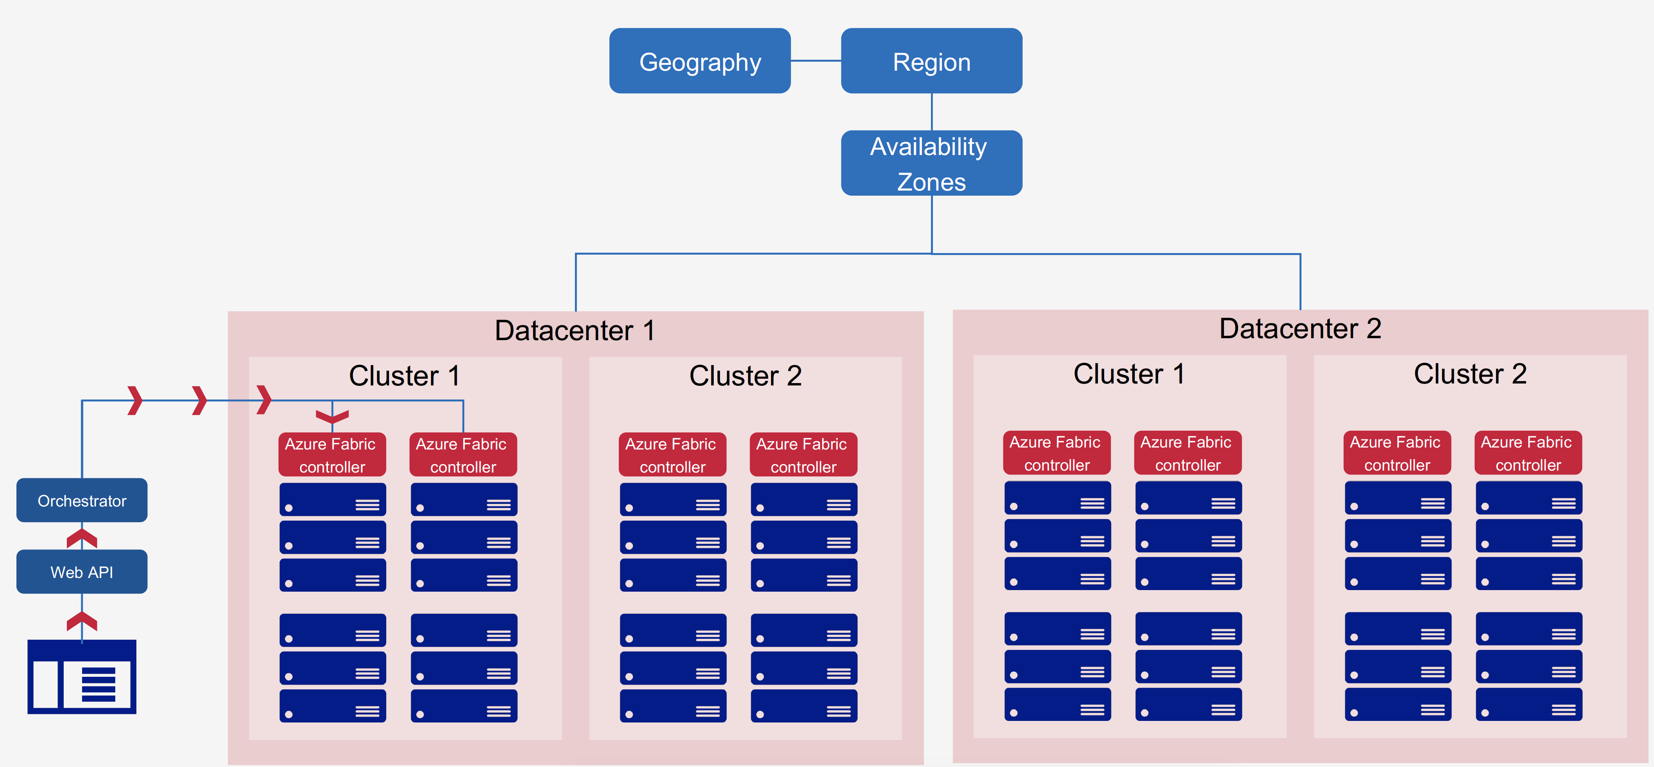
Azure Overview
Azure is over expanding Cloud Service Provider with over
100+ End to End Services
54 Global Azure Regions (42 current, 12 in Pipeline)
70 Compliance Offerings
90% fortune 500 Companies using Microsoft Cloud.
1. Geography – A Place with 2 or more Regions that preserves Data Resistency & Compliance Boundaries.
2. Region – region is a set of data centres deployed within a latency-defined perimeter and connected
through a dedicated regional low-latency network.
3. Availability Zones - physically separate locations within an Azure region. Each Availability Zone is made up of one or more data centres equipped with independent power, cooling and
networking.
https://azure.microsoft.com/en-us/global-infrastructure/regions/
http://www.azurespeed.com/Information/AzureRegions

Slide 14
Overview contd
Zonal Service – You can select Service like VM, Disk, IP etc
Zone Redundant Services – Maintained by Azure like COSMOS DB, Gateways etc.
Region Pairs – One Region paired with other region in same geography atleast 300 miles away for Natural Disaster
Availability Sets - Ability of 2 more vms that ensure Application is always Up and Running during planned and unplanned Maintainence. 2 Racs with Dedicated Power & 5 Logical update.
(AZ is replicated b/w datacenters with in a region, Av Sets are for Same Datacenter. )

Slide 15
Azure Account & Subscription types
Account – It is the Email, Name, Login , Billing, when you sign up for User, Similar to Root Account in AWS
Subscription – Services in Azure Provisioned to an Account. There can be more than 1 subscription to Account , Subscription holds details of associated resources. Billing is done based on Subscription.
Free - $200 , 1 month, Credit Card Needed, Pay as you go
Student - $100, No Credit card.
Pay as you go , Billed Monthly
Enterprise Agreement – Based on Corp Association with Azure.

Slide 16
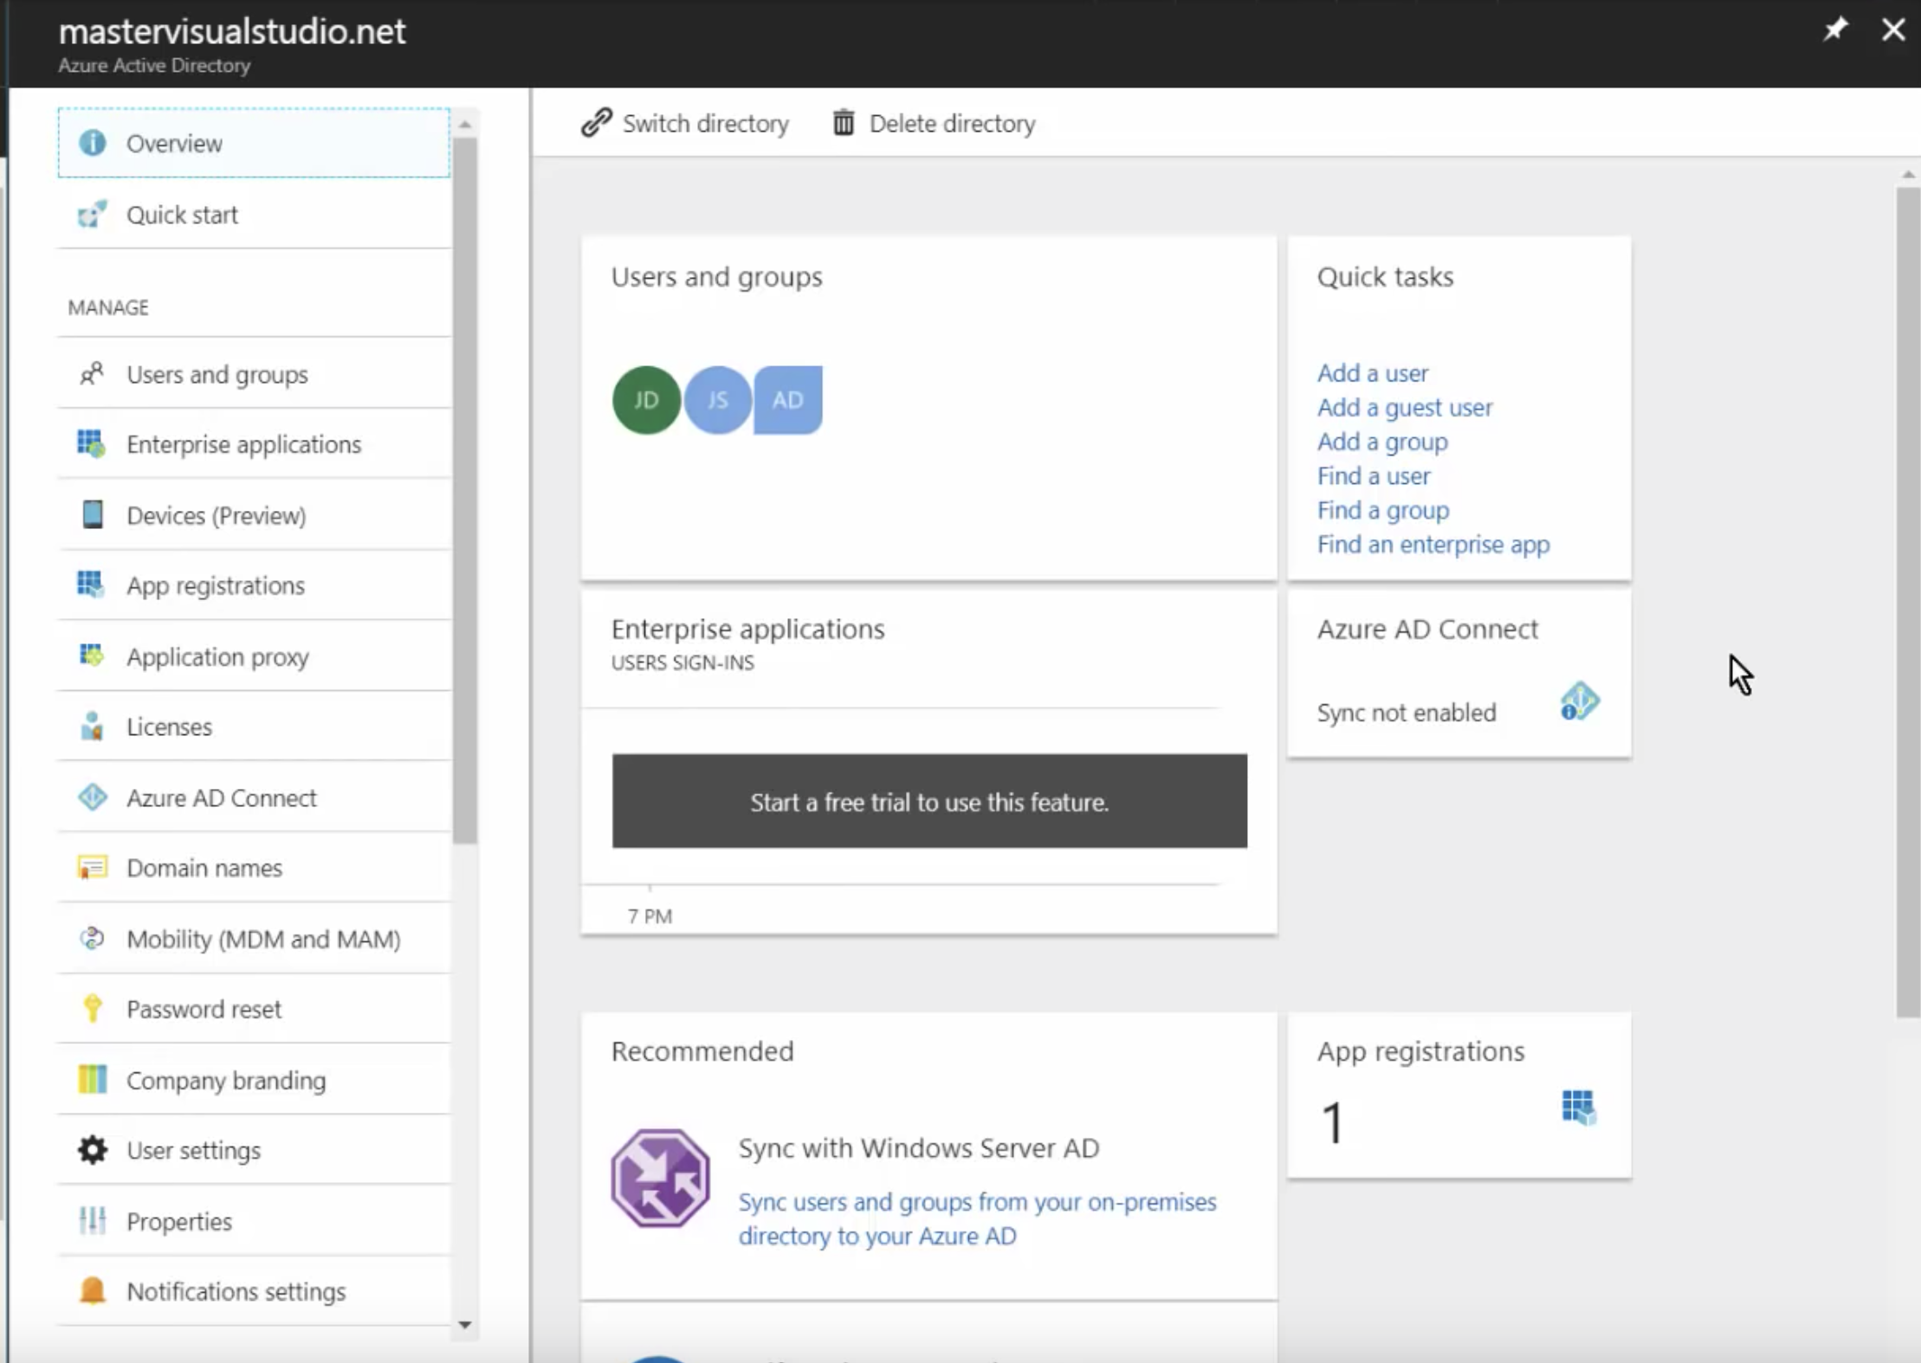
Azure AD
Latest Cloud Identity Provider that supports Multiple cloud based, Secure Authentication Protocols. (Create and Manage Domains for the VM’s) etc , You can create one domain called pklanka.org and create users under domain
Tenant – Isolated Instance of AD, Secured and owned by yourself, Team, Organization.
One tenant can have multiple Subscriptions but 1 subscription only 1 tenant
Each tenant has 1 Owner.

Slide 17
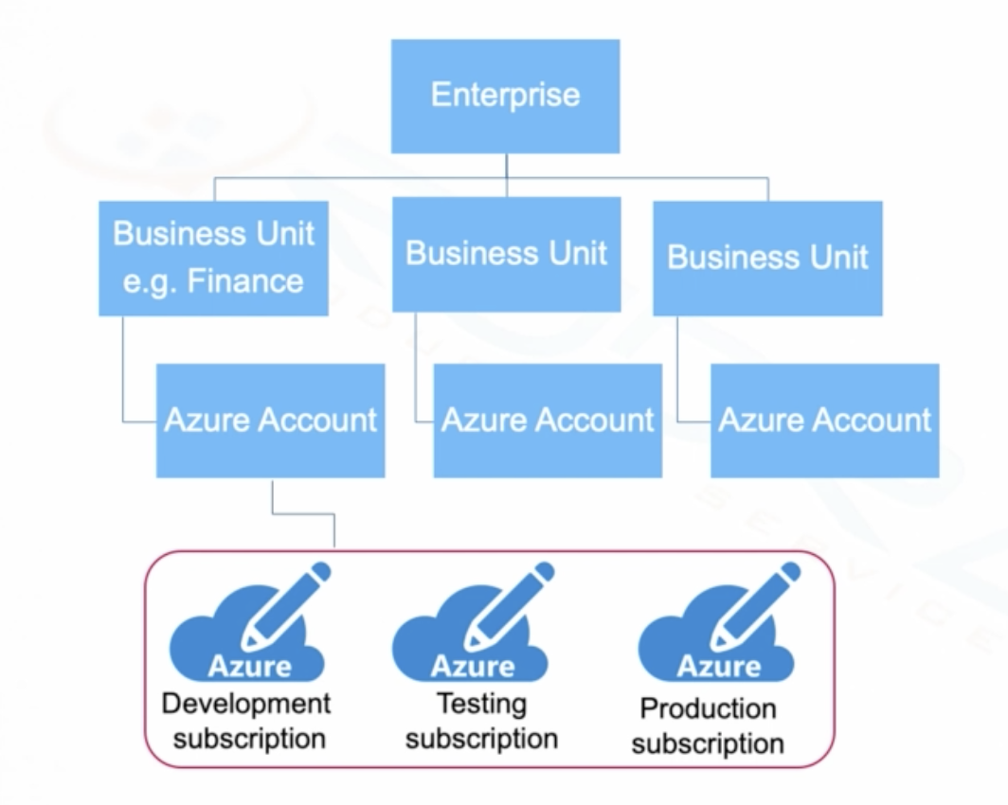
AZURE HIERARCHY
Top Level Enterprise Portal --> Create BU’s Like Finance , HR, Operations etc.
Create Azure Accounts, Dedicated AD Tenants for Finance & same for HR and Ops also.
Create Subscriptions under tenants

Slide 18
Resource Groups
Resource Groups are a fundamental element of Azure Platform, A Resource Group is a logical container for resources deployed on Azure.
One Resource can be part of one resource group but they can be reallocated to new RG
RG can be created through portal, CLI, Powershell, templates , $$SDK
Naming Standard
Organizing for Authorization (RBAC), Billing, Lifecycle
If RG is deleted , all associated resources are also deleted.
TAGS
Tags are Names/Value pair of text data that can be applied to resources or resource groups.
15 tags per resource upto 512 characters are allowed.
Tags can be used for setting up alerts.
Tags are common for Automation.
Azure Policy to Automatically add or enforce tags for resources of your organization.
Tags are not inherited, You Need to Apply tags to every supported resource you need tagged.

Slide 19
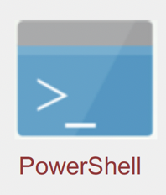
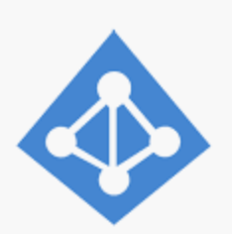
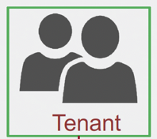
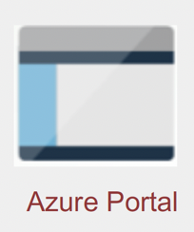

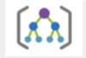

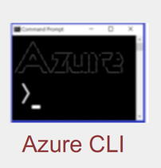
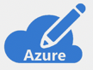


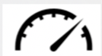


UNDERSTANDING AZURE
AZURE RESOURCE MANAGER (API)
(Manage/Deploy Resources, Authenticate, Authorize using AD)
TRUST
AZURE AD
BASED ON API REQ , DELIGATED TO PARTICULAR RP
RESOURCE PROVIDERS
MANAGEMENT GROUP (Enterprise Level)
Governance Levels
For all Subscriptions
RBAC
AZURE SUBSCRIPTION
Resource
Policies
RESOURCE GROUP
Resource
Limits
Financial
Limits
RESOURCE
(VCN/ VM / Blob)

Slide 20
Azure 10,000 ft Overview
MANAGEMENT TOOLS
APPLICATION INSIGHTS
AUTOMATION
DEVELOPER TOOLS
REST APIs
STORAGE EXPLORER & EMULATOR
BILLING
AZURE MONITOR
LOG ANALYTICS
ADVISOR
NETWORK WATCHER
VISUAL STUDIO
AZURE POWERSHELL
CLI
ARM TEMPLATES
SCHEDULER
SECURITY
AZURE B2C
AZURE MFA
AZURE WAF
IoT
(Devices connecting to internet)
IoT Central
IoT Hub
Notification Hubs
Event Hubs
IoT Edge
AZURE AD
KEY VAULT
Security Center
RBAC
EAI
Service Bus
BizTalk Services
Logic Apps
Event Grid
ANALYTICS
Data Like Analytics
Stream Analytics
Power BI
APP SERVICES
Media Services
API Management
CDN
HD INSIGHT(Hadoop)
MACHINE Learning
Cognitive Services
Notifications
Web Apps
Logic Apps
API Apps
SEARCH
Data Explorer
DATABASES
Redis Cache
Data Factory
DMS
SQL Server on VM
COMPUTE
Virtual Machine Scale Sets
K8s
Functions
SAP Hana
SQL DB
SQL DW
SQL SD
Cosmos DB
Azure DB for
Virtual Machine
CLOUD Service
Service Fabric
BATCH
ACI (Container)
NETWORK
VNet
Load Balancer
Application Gateway
Traffic Manager
Express
Route
VPN
DNS
Firewall
Virtual WAN
DDoS
STORAGE
BLOB
TABLE
QUEUE
FILE
DISK
DATA LAKE STORAGE
DATABOX
STOR SIMPLE
STORAGE EXPLORER
ARCHIVE

Slide 21
Features not Covered in Overview
Site Recovery
Azure Backups
Microsoft Azure Trust Center
Compliance Manager
Microsoft Privacy Manager
Service Principles
Azure Information Protection Plan.
AI – Machine Learning & Learning Studio
Devops – Visual Studio team services , KANBAN, Code Commits etc.
Devops Labs – Windows and Linux to test Apps.
Cognative Services – Voice / Speech / Text Processing services.

Slide 22
1. AZURE STORAGE
ID | Component | Purpose
1 | BLOB | Azure Blob Storage. Azure Blob Storage is a service for storing large amounts of unstructured object data, such as text or binary data. Common uses of Blob Storage include: Serving images or documents directly to a browser. Storing files for distributed access.
2 | TABLE | Azure Table storage stores large amounts of structured data. The service is a NoSQL datastore which accepts authenticated calls from inside and outside the Azure cloud. Azure tables are ideal for storing structured, non-relational data.
3 | QUEUE | Queue Storage is an Azure Service that enables you to put messages on the queue and asynchronously process these messages. Therefore Queue Storage is an ideal method to process events that don't require a specific order.
4 | FILE | Simple, secure and fully managed cloud file shares Extend your servers to Azure with Sync for on-premises performance and capability Secure data at rest and in-transit using SMB 3.0 and HTTPS Simplify cloud file share management using familiar tools Create high-performance file shares using the Premium Files storage tier
5 | DISK | An Azure managed disk is a virtual hard disk (VHD). You can think of it like a physical disk in an on-premises server but, virtualized. Azure managed disks are stored as page blobs, which are a random IO storage object in Azure.
6 | Data Like Storage | Data Lake Storage Gen2 makes Azure Storage the foundation for building enterprise data lakes on Azure. Designed from the start to service multiple petabytes of information while sustaining hundreds of gigabits of throughput, Data Lake Storage Gen2 allows you to easily manage massive amounts of data.
7 | Data Box | Like Snowball in AWS, If we have to xfer Huge Data to Azure , We can request for Data Box and transfer the files to that and ship it Microsoft.
8 | StorSimple | Microsoft Azure StorSimple, an integrated storage solution that manages storage tasks between on-premises devices and Microsoft AZURE cloud storage. Moreover, StorSimple uses deduplication and compression to reduce the amount of storage that the data consumes.
9 | Storage Explorer | It’s a Piece of Client Software to access all the Storage Services in Azure
10 | Archive | Azure Archive Blob Storage. Azure Archive Blob storage is designed to provide organizations with a low cost means of delivering durable, highly available, secure cloud storage for rarely accessed data with flexible latency requirements (on the order of hours)

Slide 23
2. AZURE Network
ID | Component | Purpose
1 | VNet | VNet Service Endpoints enable you to isolate connectivity to your logical server from a given subnet or set of subnets within your virtual network. Peering Allow VN from different Regions to be connected. VNet are divided into SubNets
2 | Load balancer | With Azure Load Balancer, you can scale your applications and create high availability for your services. Load Balancer supports inbound and outbound scenarios, provides low latency and high throughput, and scales up to millions of flows for all TCP and UDP applications.
3 | Application Gateway | TCP/HTTP Level LBR only. Azure Application Gateway is a web traffic load balancer that enables you to manage traffic to your web applications. This is based on Layer 7 Load Balancing
4 | Traffic Manager | Azure Traffic Manager is a DNS-based traffic load balancer that enables you to distribute traffic optimally to services across global Azure regions, while providing high availability and responsiveness.
5 | Express Route | On Prem to Azure Connectivity
6 | VPN Gateway | Like webtier in Cloud and App is in On-Prem / Cloud also.
7 | DNS | Domain Name Server (Friendly Names to Hosts)
8 | Firewall | Cloud Native Network Security to protect your Azure Virtual Network Resources
9 | Virtual WAN | Azure Virtual WAN is a networking service that provides optimized and automated branch connectivity to, and through, Azure. Azure Virtual WAN brings together many Azure cloud connectivity services such as site-to-site VPN (generally available), ExpressRoute (Preview), point-to-site user VPN (Preview) into a single operational interface. Connectivity to Azure VNets is established by using virtual network connections.
10 | DDoS | Distributed denial of service (DDoS), Ensures Application Availability only to Legitimate users. (Free and Standard).

Slide 24
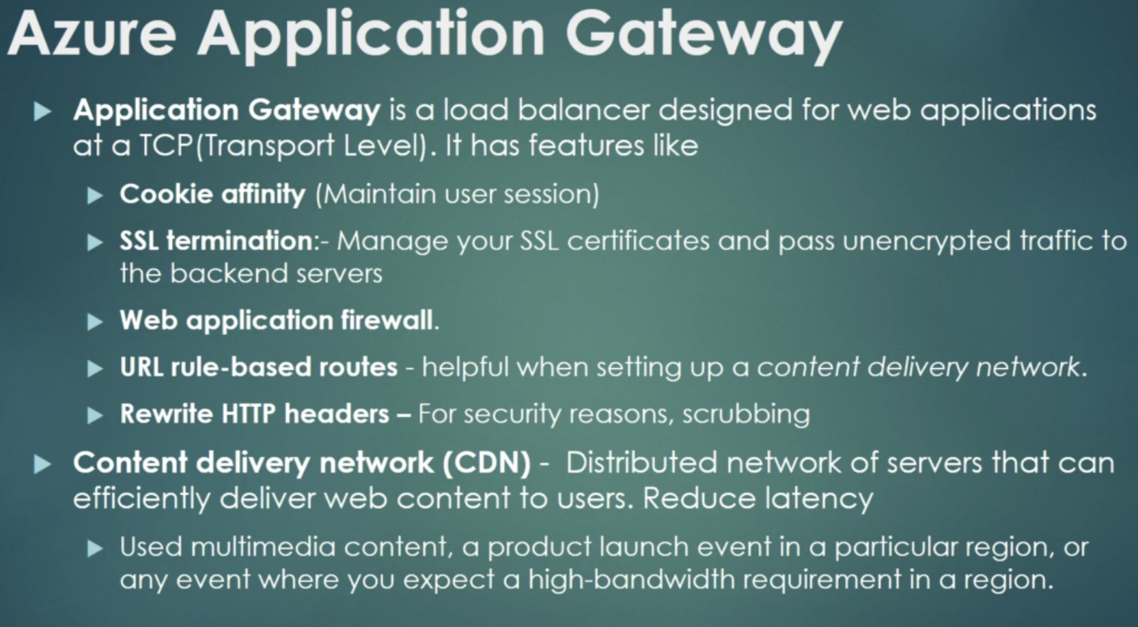
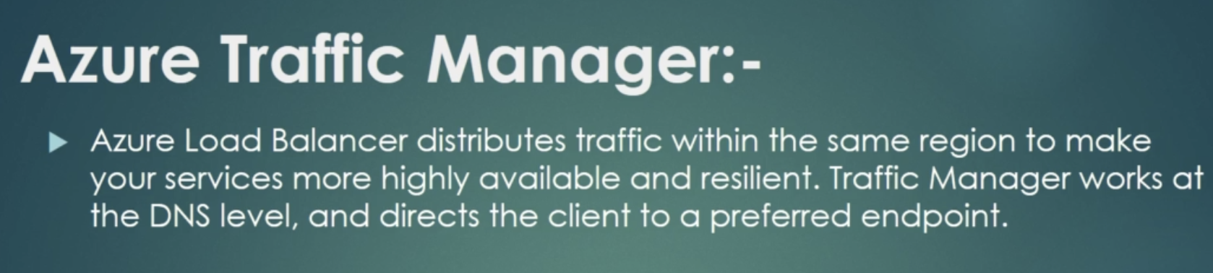

Slide 25
3. AZURE COMPUTE
ID | Component | Purpose
1 | Virtual Machine | Similar like EC2 Instance.
2 | Cloud Service | Similar to Amazon Elastic Search/ Ops Works services.
3 | Service Fabric | Develop Microservices on Windows/Linux – RUNC container, etc .
4 | Batch | Enable Large Scale Job Scheduling and compute Management in 10’s/100’s/1000’s
5 | Cycle Cloud | Enable Enterprise IT to Provide Secure & Flexible Cloud HPC (High Performance Compute)
6 | SAP Hana | Azure Large Instances for SAP HANA Based.
7 | Functions | These are like Lambda in AWS, Azure Functions. These are stateless, Code can also run Locally.
8 | Virtual Machine scale sets | Allow you to centrally Manage, Configure, and update large amounts of VM’s in Minutes to Provide High Available App. For Scaling it should be same kind of vms.
9 | K8s Service | Create Kubernetes Cluster with 1 click of button
10 | ACI / ACR | Azure Container Instance & Azure Container Registry (ECS & ECR)

Slide 26
Azure Compute App Services
4 categories
Web Apps – Supports Hosting full web ASP.NET, ASP.NET Core , Java , Ruby , Node.js , PHP or Python. You can use Windows / Linux
API Apps – Support Rest API’s and Market Place Support.
Web Jobs – Run a Program (.exe , Java/PHP/Python, Node.js) or script Use to run Large Batch Job tasks. You can run through trigger or schedule.
Mobile Apps – Build Backend for iOS, Android. Push Notification & Social App Notification are Supported.

Slide 27
Azure Logic Apps VS Functions
Azure takes care of Managing the Server infrastructure and allocation/Deallocation of Resources based on Demand.
Azure Functions – Like Lambda In AWS, This is stateless, Code can run locally also.
Azure Logic Apps - Executes workflows , the workflows are persisted as JSON with a known workflow schema. This support quick Development Framework. Stateful, Code has to be executed from Cloud, Integrated Pack of B2B. This Service is only Applicable in Cloud.

Slide 28
4. AZURE DATABASES
ID | Component | Purpose
1 | Redis Cache | A secure data cache and messaging broker that provides high throughput and low-latency access to data for applications. Tutorials, API references, and other documentation show you how to use Azure Cache for Redis from any application on Azure.
2 | Data Factory | A cloud data integration service, to compose data storage, movement, and processing services into automated data pipelines. Tutorials and other documentation show you how to set up and manage data pipelines, and how to move and transform data for analysis.
3 | DMS | The Azure Database Migration Service is a fully managed service designed to enable seamless migrations from multiple database sources to Azure data platforms with minimal downtime (online migrations).
4 | SQL Server on VM | SQL Server on Azure virtual machines enables you to use full versions of SQL Server in the Cloud without having to manage any on-premises hardware. SQL Server VMs also simplify licensing costs when you pay as you go.
5 | SQL DB | Azure SQL Database is a general-purpose relational database-as-a-service (DBaaS) based on the latest stable version of Microsoft SQL Server Database Engine. SQL Database is a high-performance, reliable, and secure cloud database that you can use to build data-driven applications and websites in the programming language of your choice, without needing to manage infrastructure.
6 | SQL DW | SQL Data Warehouse is a cloud-based Enterprise Data Warehouse (EDW) that leverages Massively Parallel Processing (MPP) to quickly run complex queries across petabytes of data. Use SQL Data Warehouse as a key component of a big data solution.
7 | SQL SD | Stretch Database migrates your cold data transparently and securely to the Microsoft Azure cloud.
8 | Cosmos DB | Azure Cosmos DB is Microsoft's globally distributed, multi-model database service. With a click of a button, Cosmos DB enables you to elastically and independently scale throughput and storage across any number of Azure regions worldwide. You can elastically scale throughput and storage, and take advantage of fast, single-digit-millisecond data access using your favorite API including SQL, MongoDB, Cassandra, Tables, or Gremlin. Cosmos DB provides comprehensive service level agreements (SLAs) for throughput, latency, availability, and consistency guarantees, something no other database service offers.
9 | Azure DB for MySQL/PostGres/Maria DB | Fully Managed RDS by Azure.

Slide 29
5. AZURE ANALYTICS
ID | Component | Purpose
1 | Data Lake Analytics | Azure Data Lake Analytics is an on-demand analytics job service that simplifies big data. Instead of deploying, configuring, and tuning hardware, you write queries to transform your data and extract valuable insights. The analytics service can handle jobs of any scale instantly by setting the dial for how much power you need. You only pay for your job when it is running, making it cost-effective.
2 | Stream Analytics | Azure Stream Analytics is an event-processing engine that allows you to examine high volumes of data streaming from devices. Incoming data can be from devices, sensors, web sites, social media feeds, applications, and more. It also supports extracting information from data streams, identifying patterns, and relationships. You can then use these patterns to trigger other actions downstream, such as create alerts, feed information to a reporting tool, or store it for later use. Following are some examples where Azure Stream Analytics can be used: Internet of Things(IoT) Sensor fusion and real-time analytics on device telemetry Web logs/clickstream analytics Geospatial analytics for fleet management and driverless vehicles Remote monitoring and predictive maintenance of hi-value assets Real-time analytics on Point of Sale data for inventory control and anomaly detection
3 | Power BI Embedded | Power BI Embedded is intended to simplify how ISVs and developers use Power BI capabilities with embedded analytics. Power BI Embedded simplifies Power BI capabilities by helping you quickly add stunning visuals, reports, and dashboards to your apps
4 | HD insight | Azure HDInsight is a managed, full-spectrum, open-source analytics service for enterprises. HDInsight is a cloud service that makes it easy, fast, and cost-effective to process massive amounts of data. HDInsight also supports a broad range of scenarios, like extract, transform, and load (ETL); data warehousing; machine learning; and IoT.
5 | Machine Learning | Azure Machine Learning service provides SDKs and services to quickly prep data, train, and deploy machine learning models. Improve productivity and costs with autoscaling compute & pipelines. Use these capabilities with open-source Python frameworks, such as PyTorch, TensorFlow, and scikit-learn.
6 | Cognitive Services | Text Speech Voice Recognition
7 | Data Explorer | Azure Data Explorer is a fast, fully managed data analytics service for real-time analysis on large volumes of data streaming from applications, websites, IoT devices, and more. You can use Azure Data Explorer to collect, store, and analyze diverse data to improve products, enhance customer experiences, monitor devices, and boost operations.

Slide 30
6. AZURE APP Services
ID | Component | Purpose
1 | CDN | Azure Content Delivery Network (CDN) is a global CDN solution for delivering high-bandwidth content. It can be hosted in Azure or any other location. With Azure CDN, you can cache static objects loaded from Azure Blob storage, a web application, or any publicly accessible web server, by using the closest point of presence (POP) server. Azure CDN can also accelerate dynamic content, which cannot be cached, by leveraging various network and routing optimizations.
2 | Media Services | Azure Media Services is a cloud-based platform that enables you to build solutions that achieve broadcast-quality video streaming, enhance accessibility and distribution, analyze content, and much more. Whether you are an application developer, a call center, a government agency, an entertainment company, Media Services helps you create applications that deliver media experiences of outstanding quality to large audiences on today’s most popular mobile devices and browsers.
3 | API Management | API Management (APIM) helps organizations publish APIs to external, partner, and internal developers to unlock the potential of their data and services. Businesses everywhere are looking to extend their operations as a digital platform, creating new channels, finding new customers and driving deeper engagement with existing ones. API Management provides the core competencies to ensure a successful API program through developer engagement, business insights, analytics, security, and protection. You can use Azure API Management to take any backend and launch a full-fledged API program based on it.
4 | Notifications | Azure Notification Hubs provide an easy-to-use and scaled-out push engine that allows you to send notifications to any platform (iOS, Android, Windows, Kindle, Baidu, etc.) from any backend (cloud or on-premises). Notification Hubs works great for both enterprise and consumer scenarios
5 | Web Apps(PAAS) | Azure App Service enables you to build and host web apps, mobile back ends, and RESTful APIs in the programming language of your choice without managing infrastructure. It offers auto-scaling and high availability, supports both Windows and Linux, and enables automated deployments from GitHub, Azure DevOps, or any Git repo
6 | Mobile Apps | Azure App Service is a fully managed platform as a service (PaaS) offering for professional developers. The service brings a rich set of capabilities to web, mobile, and integration scenarios.
7 | Logic Apps | Azure Logic Apps is a cloud service that helps you automate and orchestrate tasks, business processes, and workflowswhen you need to integrate apps, data, systems, and services across enterprises or organizations. Logic Apps simplifies how you design and build scalable solutions for app integration, data integration, system integration, enterprise application integration (EAI), and business-to-business (B2B) communication, whether in the cloud, on premises, or both.
8 | API Apps | Azure App Service enables you to build and host web apps, mobile back ends, and RESTful APIs in the programming language of your choice without managing infrastructure.
9 | Search | Azure Search is a search-as-a-service cloud solution that gives developers APIs and tools for adding a rich search experience over private, heterogenous content in web, mobile, and enterprise applications. Query execution is over a user-defined index.

Slide 31
7. EAI
ID | Component | Purpose
1 | Service Bus | Azure Service Bus is a multi-tenant cloud messaging service you can use to send information between applications and services. The asynchronous operations give you flexible, brokered messaging, along with structured first-in, first-out (FIFO) messaging, and publish/subscribe capabilities.
2 | Event Grid | Azure Event Grid is a fully-managed intelligent event routing service that allows for uniform event consumption using a publish-subscribe model. Use Azure Event Grid to react to relevant events across both Azure and non-Azure services in near-real time fashion.

Slide 32
8. IoT
ID | Component | Purpose
1 | IoT Central | Azure IoT Central is a fully managed SaaS (software-as-a-service) solution that makes it easy to connect, monitor and manage your IoT assets at scale. Azure IoT Central simplifies the initial setup of your IoT solution and reduces the management burden, operational costs, and overhead of a typical IoT project.
2 | IoT Hub | IoT Hub is a managed service, hosted in the cloud, that acts as a central message hub for bi-directional communication between your IoT application and the devices it manages. You can use Azure IoT Hub to build IoT solutions with reliable and secure communications between millions of IoT devices and a cloud-hosted solution backend. You can connect virtually any device to IoT Hub.
3 | IoT Edge | Azure IoT Edge is an Internet of Things (IoT) service that builds on top of IoT Hub. This service is meant for customers who want to analyze data on devices, a.k.a. "at the edge", instead of in the cloud. By moving parts of your workload to the edge, your devices can spend less time sending messages to the cloud and react more quickly to changes in status.

Slide 33
9. Management Tools
ID | Component | Purpose
1 | Application Insights | Application Insights is an extensible Application Performance Management (APM) service for web developers on multiple platforms. Use it to monitor your live web application. It will automatically detect performance anomalies. It includes powerful analytics tools to help you diagnose issues and to understand what users actually do with your app.
2 | Automation (Process Automation/Configuration Management) | Azure Automation delivers a cloud-based automation and configuration service that provides consistent management across your Azure and non-Azure environments. It consists of process automation, update management, and configuration features. Azure Automation provides complete control during deployment, operations, and decommissioning of workloads and resources
3 | Log Analytics | Log data collected by Azure Monitor is stored in a Log Analytics workspace, which is based on Azure Data Explorer. It collects telemetry from a variety of sources and uses the Kusto query language used by Data Explorer to retrieve and analyze data. (Create Alert Rules, Dashboards,Views,Export the views, API Support) Write QUERIES.
4 | Network Watcher | Azure Network Watcher provides tools to monitor, diagnose, view metrics, and enable or disable logs for resources in an Azure virtual network. (Monitor Connection b/w a VM and end point)
5 | Scheduler | Azure Scheduler helps you create jobs that run in the cloud by declaratively describing actions. The service then automatically schedules and runs those actions. For example, you can call services inside and outside Azure, such as calling HTTP or HTTPS endpoints, and also post messages to Azure Storage queues and Azure Service Bus queues or topics. You can run jobs immediately or at a later time. Scheduler easily supports complex schedules and advanced recurrence. Scheduler specifies when to run jobs, keeps a history of job results that you can review, and then predictably and reliably schedules workloads to run.

Slide 34
Azure Monitoring
Azure Monitor maximizes the availability and performance of your applications by delivering a comprehensive solution for collecting, analyzing and acting on telemetry from your cloud and on-premise environments.
Application Insights – Service that monitors the availability, performance, and usage of your web applications, whether they are hosted in On Prem or Cloud
Azure Monitor for Containers – Monitoring the Containers, workloads that are deployed to AKS
Azure Monitor for VM’S – Service to Monitor the Azure VM’s at scale by analyzing the Performance and health of your windows and Linux VM’s
It can send Alerts and also auto scale to resolve issues.

Slide 35
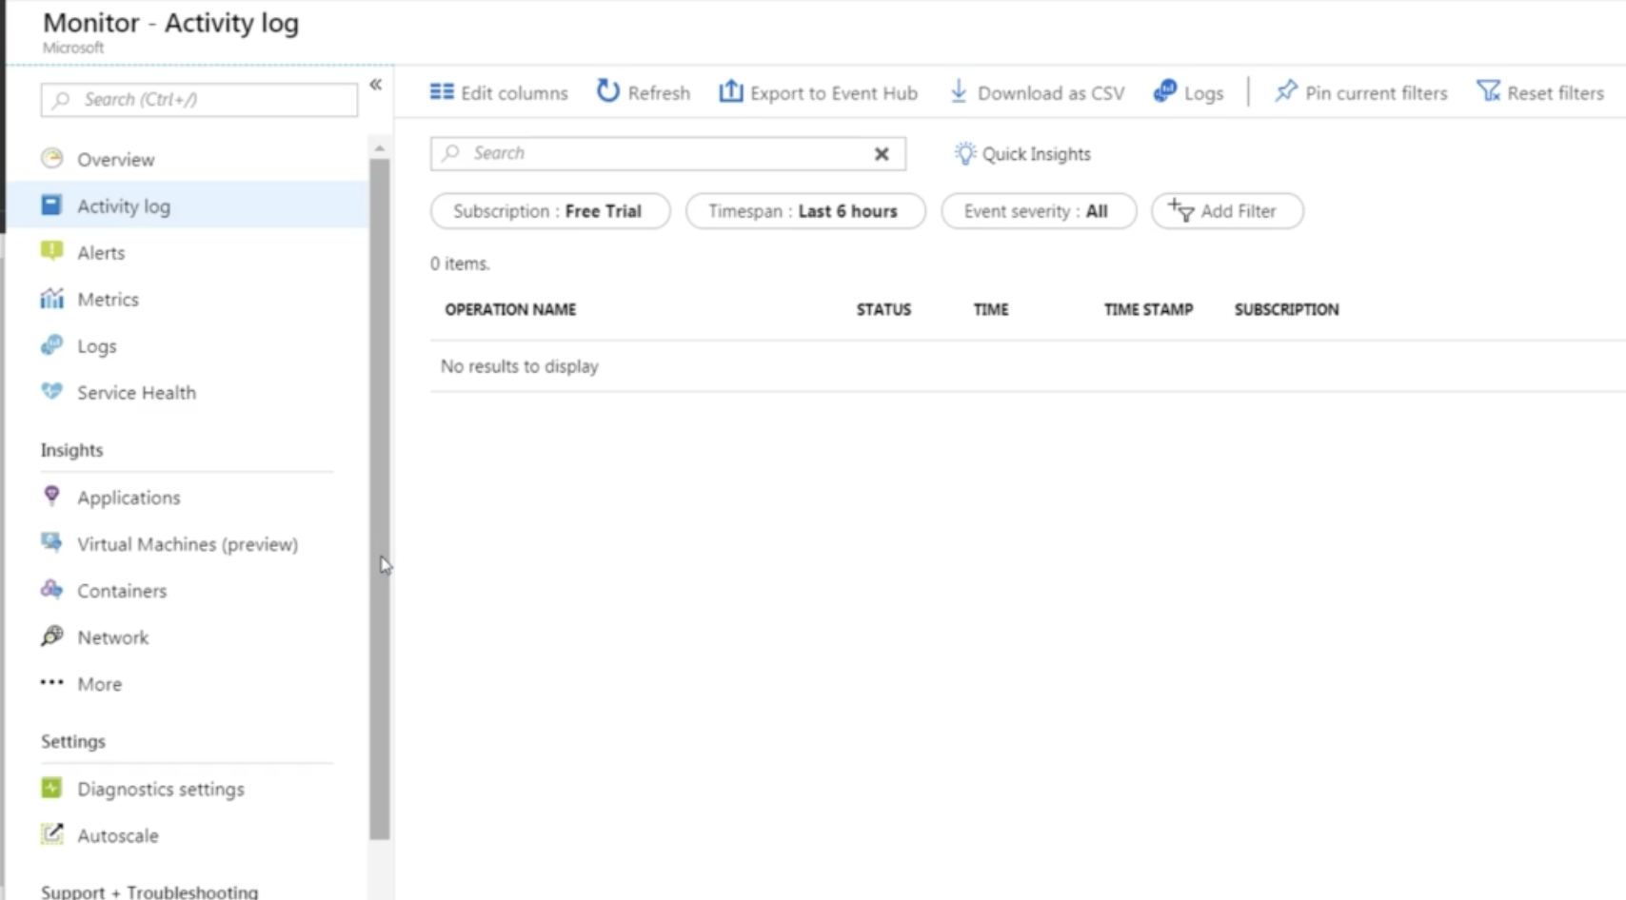
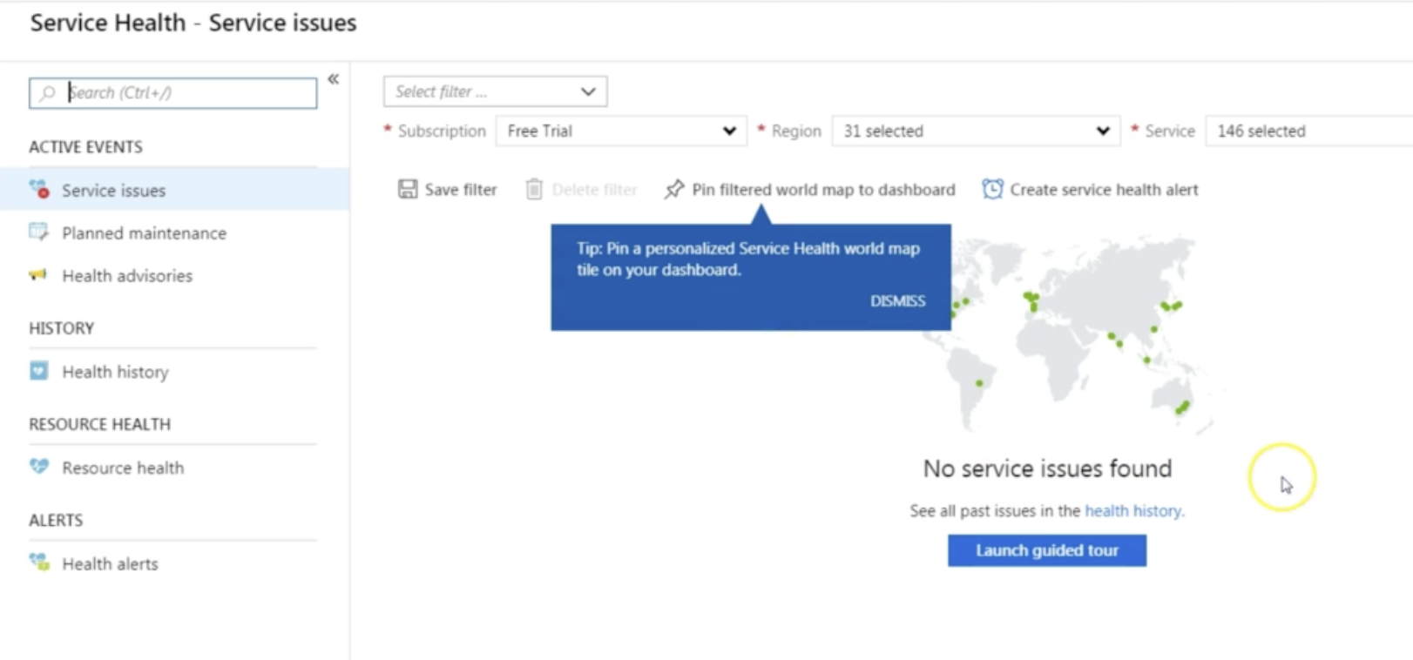
Azure Monitoring Service
Azure Service Health – is a suite of experiences that provides personal guidance and support when issues with services
Service Health – Provides you with a customizable dashboard that tracks the state of your Azure Services in the regions where you see them. This is generic Global Dashboard.
Resource Health – Helps you Diagonise and obtain support when an Azure service issue affect your resources. It provides you details with about the current and past state of your resources.

Slide 36
10. Developer Tools
ID | Component | Purpose
1 | Storage Explorer & Emulator | Software on Desktop to explore all Azure Storage Services
2 | Visual Studio APP (IDE) | You can build apps, Games, using windows/mac with Android, Web, Windows, IOS or cloud Deployments.
3 | Azure PowerShell | Portal Shell or CLI on Cloud (Has windows/Linux Edition)
4 | CLI | Azure cli based utility to manage Azure Resources
5 | ARM Templates | Azure Resource Manager Templates, JSON templates (Similar like Cloud Formation)

Slide 37
11. Azure Security
Layered Approach of Security → Physical Security → Identity & Access → Network →
Application → Data
ID | Component | Purpose
1 | Azure B2C | Azure Active Directory (Azure AD) B2C is an identity management service that enables you to customize and control how customers sign up, sign in, and manage their profiles when using your applications. This includes applications developed for iOS, Android, and .NET, among others. Azure AD B2C enables these actions while protecting the identities of your customers at the same time.
2 | Azure MFA | Multi Factor Authentication using Microsoft Authenticator
3 | WAF | Web Application Firewall , The WAF uses OWASP rules to protect your application. These rules include protection against attacks such as SQL injection, cross-site scripting attacks, and session hijacks. After creating the application gateway, you test it to make sure it's working correctly. With Azure Application Gateway, you direct your application web traffic to specific resources by assigning listeners to ports, creating rules, and adding resources to a backend pool. For the sake of simplicity, this tutorial uses a simple setup with a public front-end IP, a basic listener to host a single site on this application gateway, two virtual machines used for the backend pool, and a basic request routing rule.
4 | Azure AD | Azure Active Directory (Azure AD) is Microsoft’s cloud-based identity and access management service. Azure AD helps your employees sign in and access resources in: External resources, such as Microsoft Office 365, the Azure portal, and thousands of other SaaS applications. Internal resources, such as apps on your corporate network and intranet, along with any cloud apps developed by your own organization.
5 | KeyVault | Management Service for Managing Application Secrets (These include username, passwords, AD Accounts, Encryption Keys, SSL Keys) , They are stored using key value pairs.
6 | Security Center | It is a Monitoring Service that Provides threat Protection across all services in Azure & On Prem (Provides Recommendations, Monitor, Use Learning to Block Malware) – Act like Proactive and Reactive Free , Std ($15 per node per month) Detect > Access > Diagonize > Stablize > Close
7 | Azure Firewall | Fully Managed Cloud Based , Network Security Service that protects your Virtual Instances

Slide 38
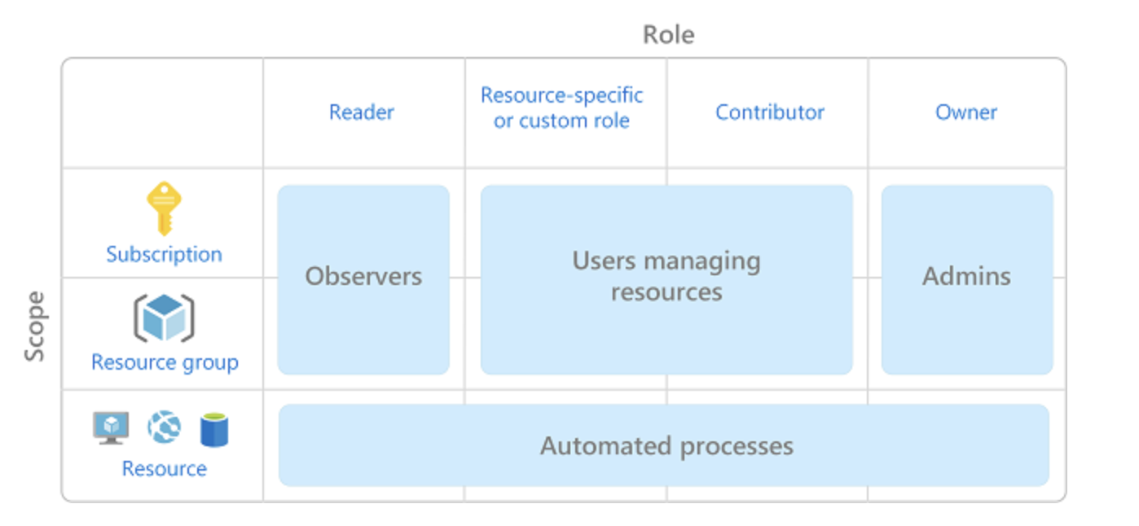
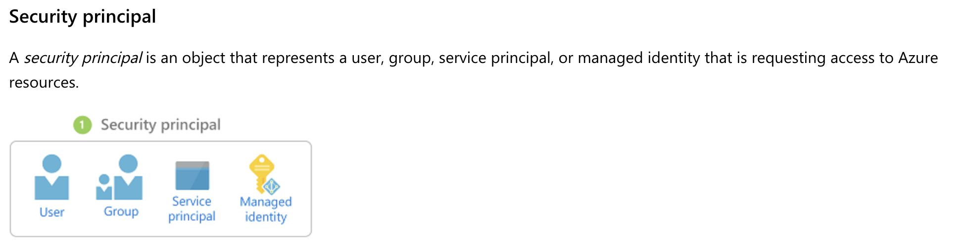
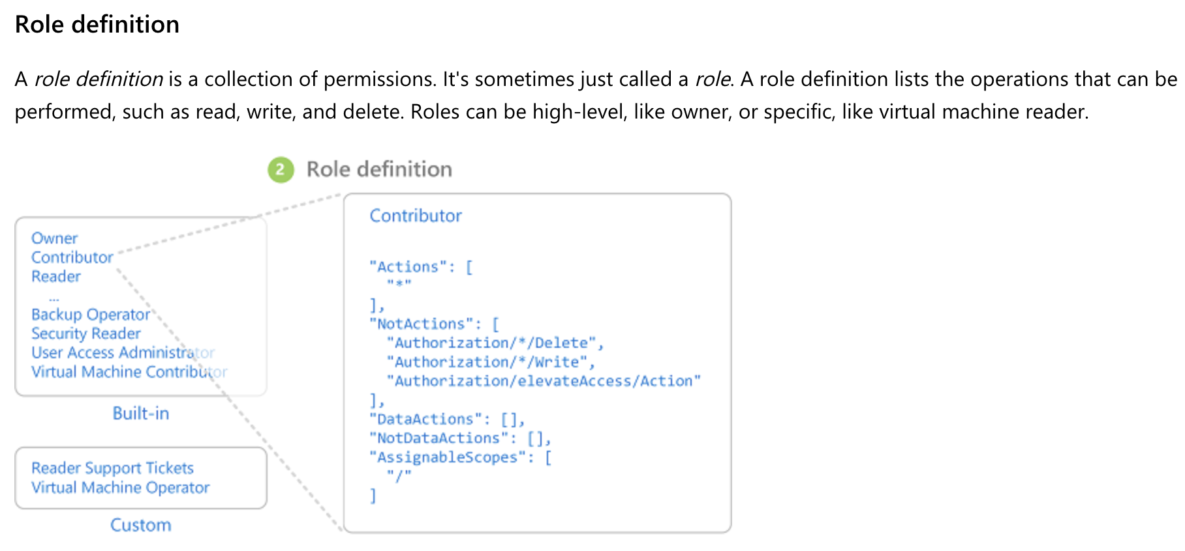
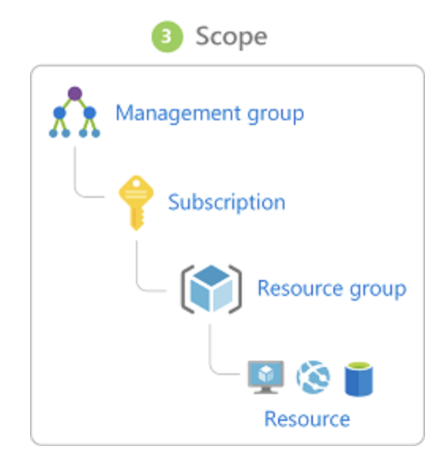
RBAC
Access management for cloud resources is a critical function for any organization that is using the cloud. Role-based access control (RBAC) helps you manage who has access to Azure resources, what they can do with those resources, and what areas they have access to.
RBAC is an authorization system built on Azure Resource Manager that provides fine-grained access management of Azure resources.
What can I do with RBAC?
Here are some examples of what you can do with RBAC:
Allow one user to manage virtual machines in a subscription and another user to manage virtual networks
Allow a DBA group to manage SQL databases in a subscription
Allow a user to manage all resources in a resource group, such as virtual machines, websites, and subnets
Allow an application to access all resources in a resource group

Slide 39
Security
Security Policy – Policy that defines set of controls that are recommended for resources within in that specified subscription or resource Group
Key Vault – Centralized Storage for Storing your Application Secrets.
Secret Management – Passphrase
Key Management – Encryption & Decryption Keys.
Certificates Management
Store Secrets by Hardware (HSM) Hardware security Model.
DDoS (Distributed Denial of Service)
Basic
Standard – Uses Protection Policies and Protect against Volumetric, Protocol and Resource Attacks.
Azure Document Protection – Microsoft Azure Information Protection (MSIP/AIP) – Cloud Based Solutions that helps and Optionally Protect docs and emails by Applying Labels, It can encrypt Credit card Info as well.
Azure ATP – Advanced Threat Protection – Protect against threats
ATP Sensors are installed in Domain Controllers to Capture all Network Activity including the logins.

Slide 40
Identity & Access Mgmt
Authentication – Identifying Person as Per user / Password/ MFA etc.
Authorization - Identifying what roles exist for the users.
Azure AD
Authentication – MFA (Password, Face or fingerprint , Mobile App)
SSO – one time Authentication
Application & Device Management
Service Principle – Identify that is used by Application or services
(Run as Administrator)
RBAC – Role Based Access Control , Roles can be granted at Individual Service instance level. Roles assigned at a Higher scope like entire Subscription, are inherited by child scopes.
Privileged Identity Management – Tool Provided by Azure Portal for Role Assignment.

Slide 41
Azure Encryption
Symmetric Encryption – uses the same key for encrypting and Decrypting the data.
Asymmetric Encryption – Uses a Public & Private Key Pair.
Encryption at Rest is at Stored Data , This is supported for Blobs , Files etc.
Encrypt Virtual Machine Disk for Disk Encryption
TDE (Transperant Data Encryption) – for SQL Database.
Encryption in Transit is during Communication like HTTP / HTTPS, VPN for Secured Channel.

Slide 42
Azure Policy
Azure Policy is a Service in Azure that you use to Define , Assign , and Manage Standards for resources in your environment. It can be used for Company wide standards. Savable as json format.
Allow Storage Accounts SKU
Allow Resource Type
Allowed Locations – Eg If Company is US Based, All things should be US based , if any one is creating outside of US, it will not allow.
Allowed Virtual Machine SKUs
Initiative – Definition set or Group of Policy Definitions to help track of your compliance state.
Azure Management Groups – Containers for Managing Access, Policies and Compliance across Multiple Azure Subscriptions. Management Groups Allow you to order your Azure Resources hierarchy into collections , which provide a further level of classification that is above the level of subscriptions.

Slide 43
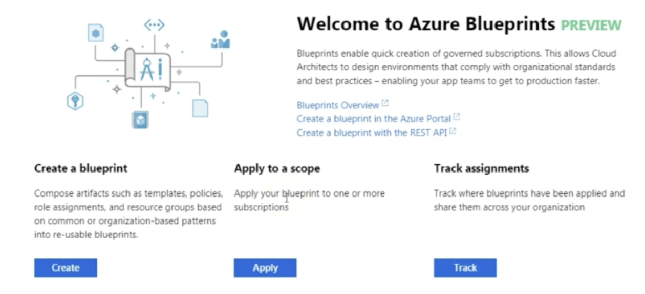
Azure Blue Print
Azure Blueprint allows you to define a repeatable set of Azure Resources that implement and adhere to your Organization Standards, Patterns and requirements.
Azure Resource Manager Templates to Deploy Resources , they have no relationship with the deployed Resources where as the blueprint can remain active. (Cloud formation Templates in Azure)

Slide 44
Compliance Manager
Microsoft Privacy Statement – Explains what personal Data Microsoft Process , How Microsoft Process it , and for what purposes.
Trust Center is a Website resource containing information and details about how Microsoft implements and supports security , Privacy , compliance , and transparency in all Microsoft Cloud Products and services , https://www.microsoft.com/en-us/trustcenter/default.aspx
Service Trust Portal – Hosts the compliance Manager service , and is the Microsoft public site for publishing audit reports and compliance related information relevant to Microsoft cloud services , https://servicetrust.Microsoft.com
Compliance Manager is a workflow based risk assessment dashboard within the trust portal that enables you to track, assign, and verify your organization’s regulatory compliance activities related to Microsoft Professional Services.

Slide 45
Azure Cost Management – 25% Questions.
Here are 3 Main Customer types on which the available the purchasing options for Azure Products
Enterprise
Web Direct
Cloud Solution Provider
Usage Meters - Track the Resources usage and generate a usage record that is used to calculate bill on Monthly basis. This is based on many factors including the vm, data transfer IN/OUT , Disk , BLOB etc.
Factors effecting the cost –
Resource Type
Service Type – Ent, Web direct etc.
Location

Slide 46
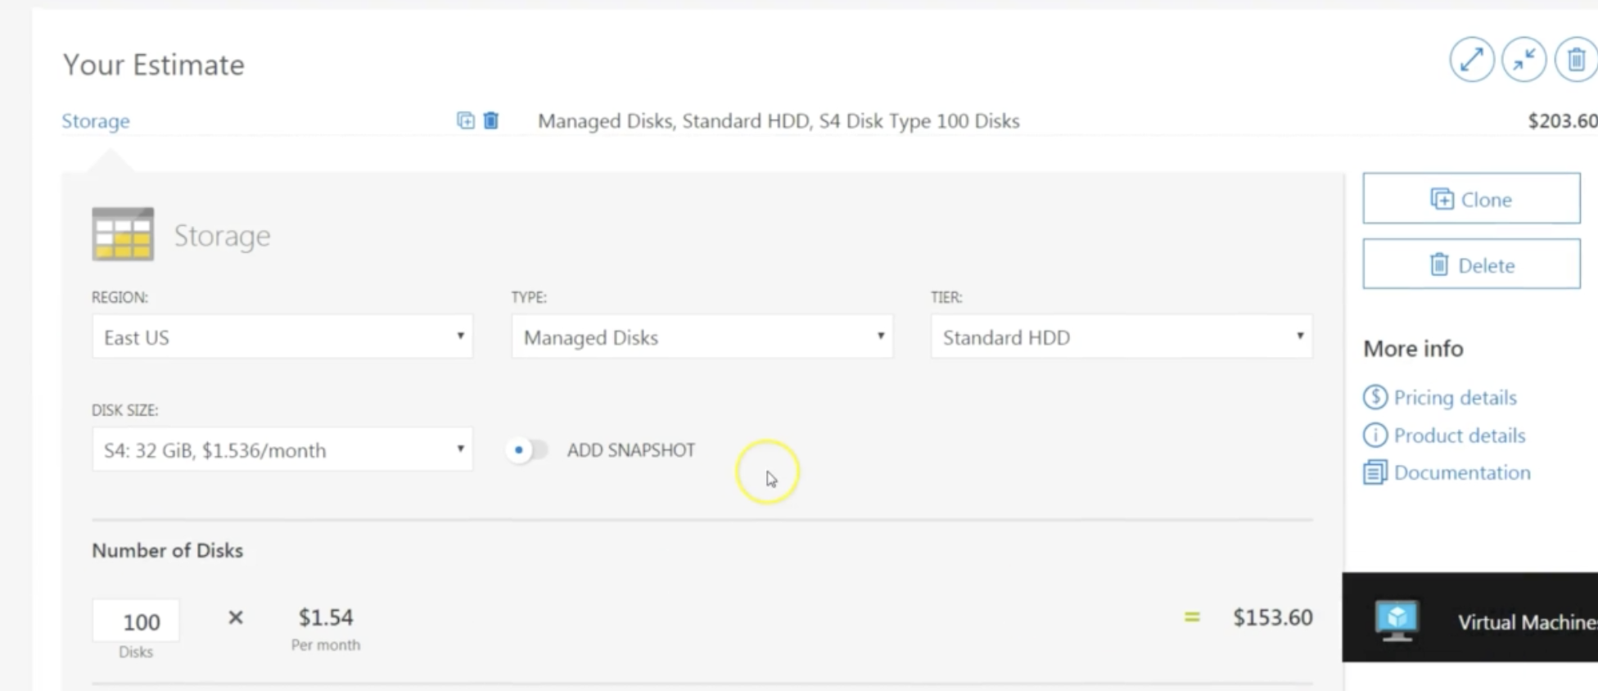
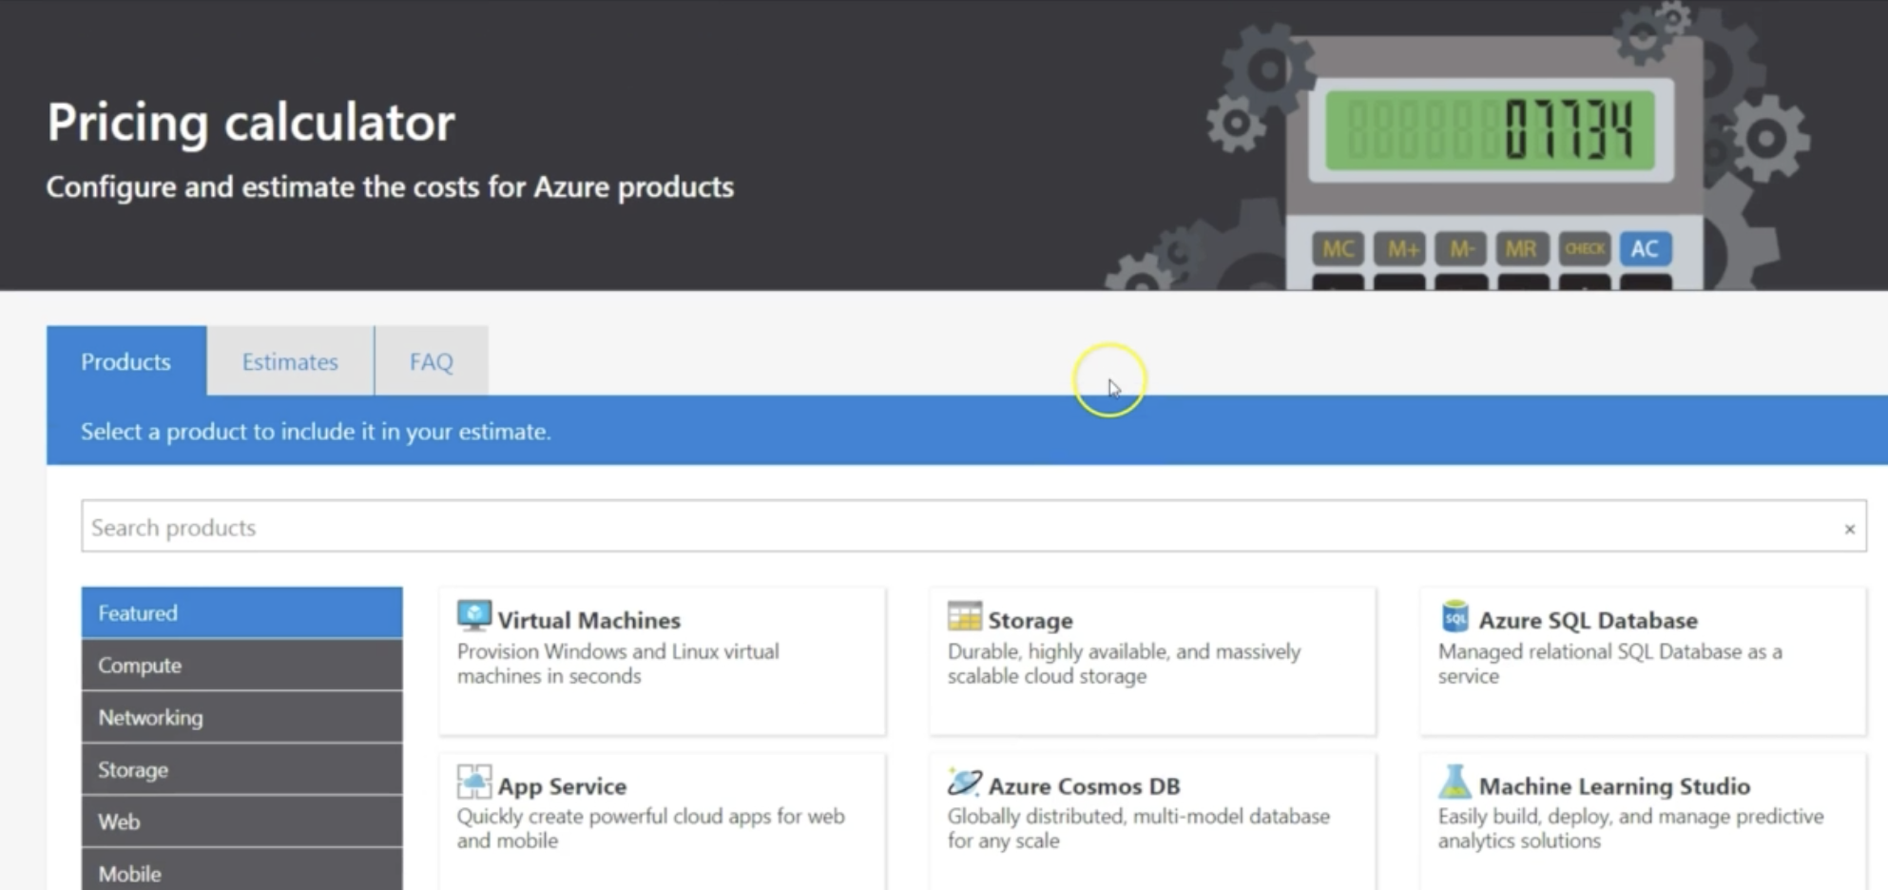
Azure Price Calculator
https://azure.microsoft.com/en-in/pricing/calculator/
Region, Tier, Billing Option, Support Options, Test/Prod etc.
Products tab: This is where the Services are selected and estimated.
Estimates: Achieved estimates
The estimates can be downloaded, Shared.

Slide 47
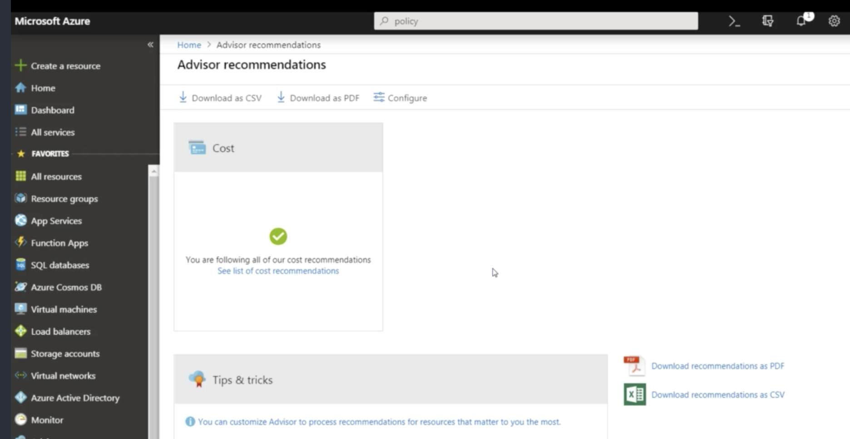
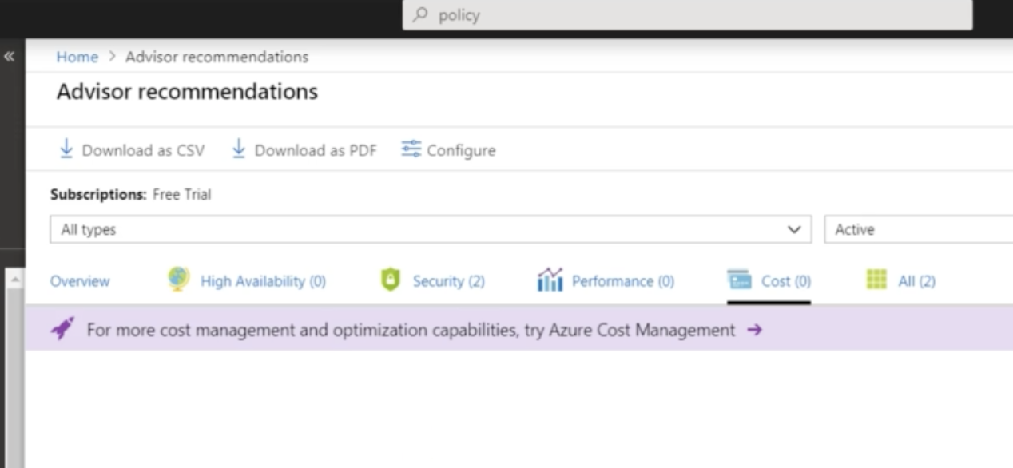
Azure Advisor
Azure Advisor is a free service built into Azure that provides recommendations on High Availability , Security , Performance and cost.
Suggest on Unused resources such as express route.
Buy Reserved instances instead of pay as you go.
Right Size of Resources.
Azure Cost Management is anathor free built in Azure tool that can be used to gain greater insights. Tracks budget vs actual.
Cloudyn, allows you to track cloud usage and expenditures for your Azure resources and other cloud providers.

Slide 48
Total cost ownership
https://azure.microsoft.com/en-in/pricing/tco/calculator/
Includes total cost vs cloud comparision. Including the IT Labor, Licensing Costs.
Four Groups are Servers, Databases, Storage, Networking.
Saving Cost on Azure
Use Azure Credits – Monthly Credit by Azure By Level.
Use Spending limits – Use Prepaid like Scenario
Use Reserved instances – Buy ahead and get discount for 1-3 year commitment, 80% cheaper.
Choose Low Cost Regions but beware of the data transmission cost.
Right Size of VMS
Shutdown or delete VM when no use.
Migrate to PAAS or SAAS

Slide 49
Repurposing License on Azure
Azure Hybrid Benefit gives customers the right to use windows server licenses for virtual machines on Azure.
Azure Hybrid benefit for SQL Enables you to use SQL Server licenses with active software Assurance to pay a reduced rate.
Use Dev/Test Subscription offers – charges the Linux rate only.
Bringing your own license (BYOL) – images off the Azure Market Place, giving you the ability to take advantage of these unused licenses and reduce your Azure VM Cost.
SQL Server Developer edition is a free product for Non Production use.

Slide 50
Important Links and References
Azure Documentation - https://docs.microsoft.com/en-gb/azure/
Azure Portal – https://portal.azure.com/
Azure Public & Private Preview is possible – https://preview.portal.azure.com
All Azure Services - https://docs.microsoft.com/en-gb/azure/#pivot=products&panel=all
SDK → https://docs.microsoft.com/en-gb/azure/#pivot=sdkstools
Architecture Suggestions & Arch Center → https://docs.microsoft.com/en-gb/azure/#pivot=architecture
Advanced Threat Protection → https://portal.atp.azure.com
Microsoft Trust Center → https://www.microsoft.com/en-us/trustcenter/default.aspx
STP Service Trust Portal (It has Reports) → https://servicetrust.microsoft.com/
Azure Pricing Calculator - https://azure.microsoft.com/en-in/pricing/calculator/
Total Cost Ownership - https://azure.microsoft.com/en-in/pricing/tco/calculator/

